Slide 1
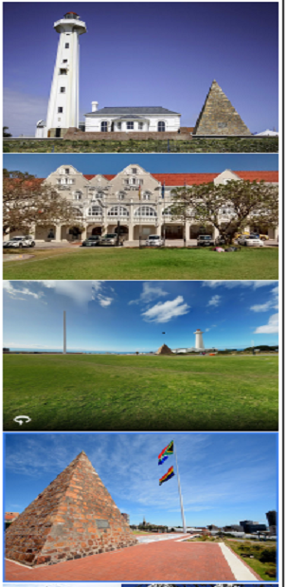
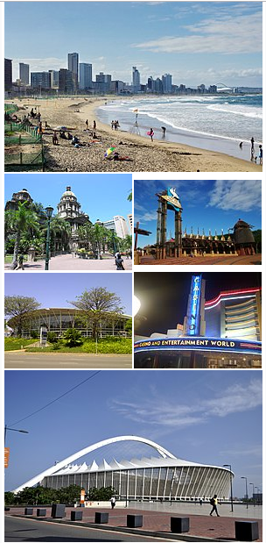
**** BATTLE OF NEIGHBORHOODS ****
Port Elizabeth & Durban City
In South Africa
** Capstone Project **
| Mr. Bhushan Khairkhar | | Data Science | Jan 2019 |
PORT ELIZABETH Vs. DURBAN

Slide 2
Agenda
Introduction
Data
Methodology
Results
Discussion
Conclusion
Notes:
2

Slide 3
Introduction
When thinking about relocating to a new city or country for work purposes or to start a new life, or to go for a holiday destination people tend to research areas before moving. This research includes population rate, average house price, school ratings, crime rates, weather conditions, recreational facilities, holiday destinations-tourism, Carnivals and Sports events/activity. etc.
Based on the above, a search engine algorithm would be an efficient tool to use that will allow users to enter cities and get the neighborhood name that best suits their lifestyle or living conditions.
In this project, we will study in detail the area classification using foursquare data and machine learning segmentation and clustering. And segment areas of two cities based on the most common places captured from Foursquare.
This could be done as the aim of this Project using an algorithm (Using segmentation and clustering) that will perform an extensive analysis on
The similarities and dissimilarities between neighborhoods in the two cities of the user’s search criteria, and
Determine which neighborhoods best suits their lifestyle.
For this project, I will be developing a recommendation system using the Port Elizabeth and Durban cities in South Africa as my search criteria:
Notes:
3

Slide 4
Introduction Continue……..
** Brief Information About: Port Elizabeth and Durban **
Port Elizabeth and Durban are two major cities in South Africa Both the cities become a center of attention for residential, holiday destinations-tourism, education, job employment, shopping and sports activity. Both cities are well known in South Africa and become the top choice for local and foreign communities. Also for the best holiday destinations in the world because of its Mediterranean climate, vibrant nightlife, Michelin Star restaurants, scenic coastal drives, staggering mountain landscape and friendly people; the latter holds the top spot as a family-friendly destination and for its wonderful beaches and water activities.
(Source - https://en.wikipedia.org/wiki/Port_Elizabeth )
(Source - https://en.wikipedia.org/wiki/Durban )
**Target Audience**
Through this project we are expecting following people to benefit out of the findings.
People migrating city for work.
Business person looking for new location to start office etc.
Tourist.
Restaurants to finalized menu based on the type or people, their likings based on feedbacks etc.
Sports Events, Activities Organizers and many more.

Slide 5
Data
Required data can be gathered from:
- Port Elizabeth and Durban City information, including districts and neighborhoods, can be obtained from Wikipedia:
(Source - https://en.wikipedia.org/wiki/Port_Elizabeth) &(Source - https://en.wikipedia.org/wiki/Durban )
Photos and Picture of Port Elizabeth and Durban City used for Presentation from (Source - https://afrotourism.com/travelogue/)
The data used for this project will be acquired from http://www.sapostalcodes.info. The datasets consists of the postal codes and suburb names of each city.
In order to obtain venues and their categories we will use Foursquare API search feature [FOURSQUARE] (https://foursquare.com/ ) will be used to collect neighborhood venue information as well as the longitude and latitude details of each suburb. Details about local venues and locality will provide insight into the qualities of a neighborhood.
In addition to Foursquare, various python packages will be used to create maps and machine learning models to gather further insights and provide efficient recommendations and results into our neighborhood battle project.
These packages includes:
Pandas - Library for Data Analysis
NumPy – Library to handle data in a vectorized manner
JSON – Library to handle JSON files
Geopy – To retrieve Location Data
Folium – Map rendering Library
Geocorder - For geolocation of neighborhoods
Requests – Library to handle http requests
Matplotlib – Python Plotting Module
Sklearn – Python machine learning Library
Notes:
5

Slide 6
OBJECTIVE
Collect the suburbs top venues using Foursquare
Form suburb clusters based on venue categories using unsupervised k-means clustering algorithm
Identify and understand the similarities and differences between Port Elizabeth and Durban suburbs to obtain insights into the suburbs

Slide 7
Methodology
HTTP requests would be made to this Foursquare API server using postal codes of Port Elizabeth Suburbs and Durban Suburbs to pull out the latitude and longitude which will be used for creation of the map as well data analysis.
Using credentials Foursquare API search feature would be enabled to collect the nearby places of the suburbs. Due to http request limitations, the number of places per suburb parameter would be set to 100 and the radius parameter would be set to 700.
Folium- Python visualization library would be used to visualize the suburbs cluster distribution of Port Elizabeth and Durban over an interactive leaflet map.
Extensive comparative analysis of two suburbs world be carried out to derive the desirable insights from the outcomes using python’s scientific libraries Pandas, NumPy and Scikit-learn.
Unsupervised machine learning algorithm K-mean clustering would be applied to form the clusters of different categories of places residing in and around the neighborhoods. These clusters from each of those two chosen suburbs would be analyzed individually collectively and comparatively to derive the conclusions.

Slide 8
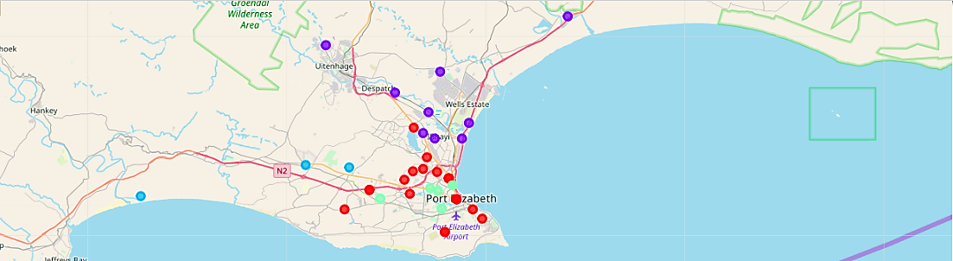
Results
1. Outcomes – Port Elizabeth, South Africa
The K-means method was used to cluster the suburbs of Port Elizabeth city into 5 clusters. The details of the clusters are as follows:
Cluster 1 -25 Suburbs
Common Venus include Restaurants, Coffee Shops, Grocery Store, Nightclubs and Shopping Mall
Cluster 2 - 13 Suburbs
Common Venues include Fast Food Restaurant, Coffee Shops, Bookstores, Restaurants, Clothing Store, and Electronics Store
Cluster 3 – 04 Suburbs
Common Venues include Convenience Store, Coffee Shops, Thai Restaurant, Fast Food Restaurant Pubs, Accessory Stores and Electronics Store
Cluster 4 - 14 Suburbs
Common Venues include Fast Food Restaurants, Winery, Beaches and Cafes, Thai Restaurant, Grocery Store, Department Store
Cluster 5 -1 Suburbs
Common Venues include Thai Restaurant, Grocery Store, Fried Chicken Joint, Fast Food Restaurant, Electronics Store, and Department Store
Fig – Visualization - The Resulting Clusters Of Port Elizabeth City
Notes:
8

Slide 9
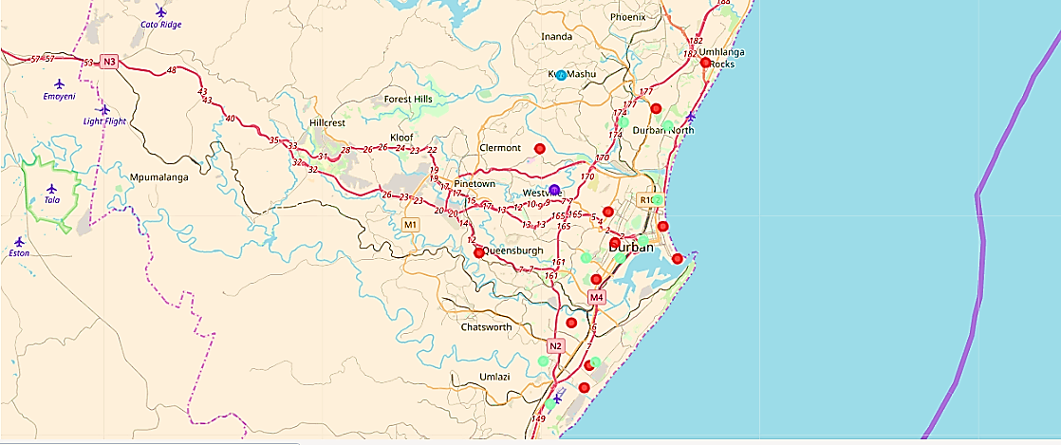
Results
Cluster 1 -23 Suburbs
Common Venues include Hotels, Lawyer, Water Park, Gift Shop, Electronics Store, Fast Food Restaurant, Flea Market, Furniture / Home Store, Gas Station, Gastropub, Golf Course.
Cluster 2 -2 Suburbs
Common Venue is Lawyer, Water Park, Gift Shop, Electronics Store, Fast Food Restaurant, Flea Market, Furniture / Home Store, Gas Station, Gastropub, Golf Course.
Cluster 3 - 3 Suburbs
Common Venues include Gastro pub, DepartmentStore, Electronics Store, Fast Food Restaurant, Flea Market, Furniture / Home Store, Gas Station, Gift Shop.
Cluster 4 - 25 Suburbs
Common Venues include Water Park, Gift Shop, Electronics Store, Fast Food Restaurant, Flea Market, Furniture / Home Store, Gas Station, Golf Course.
Cluster 5 - 4 Suburbs
Common Venues include Water Park, Gift Shop, Electronics Store, Fast Food Restaurant, Flea Market, Furniture / Home Store, Gas Station, Golf Course
2. Outcomes – Durban, South Africa
The K-means method was used to cluster the suburbs of Durban into 5 clusters. The details of the clusters are as follows:
Fig – Visualization - The Resulting Clusters Of Durban City
Notes:
9

Slide 10
Discussion
PORT ELIZABETH City Vs. DURBAN CIty
Port Elizabeth has suburbs with 76 venues. In addition, the geographical coordinate of Port Elizabeth, South Africa are -33.9617051, 25.6207519. The best suburb to stay in is GAMTOOS with the following venues:
Suburb GAMTOOS
1st Most Common Venue Convenience Store
2nd Most Common Venue Thai Restaurant
3rd Most Common Venue Clothing Store
4th Most Common Venue Grocery Store
5th Most Common Venue Gas Station
6th Most Common Venue Fried Chicken Joint
7th Most Common Venue Fast Food Restaurant
8th Most Common Venue Electronics Store
9th Most Common Venue Diner
10th Most Common Venue Department Store
Durban has 69 suburbs with 132 venues. In addition, the geographical coordinate of Durban, South Africa are -29.861825, 31.009909. The best suburb to stay in is DURBAN INTERNASIONALE LUGHAWE with the following venues:
Suburb DURBAN INTERNASIONALE LUGHAWE
1st Most Common Venue Airport
2nd Most Common Venue Water Park
3rd Most Common Venue Gift Shop
4th Most Common Venue Electronics Store
5th Most Common Venue Fast Food Restaurant
6th Most Common Venue Flea Market
7th Most Common Venue Furniture / Home Store
8th Most Common Venue Gas Station
9th Most Common Venue Gastropub
10th Most Common Venue Golf Course
Many of the neighborhoods are homogenous and are very similar to each other. Both Port Elizabeth and Durban City consist of suburb clusters that contain majority of the suburbs.

Slide 11
Conclusion
Durban had a significant more number of suburbs and venues than Port Elizabeth therefore it would be the better option to relocate to Durban, specifically DURBAN INTERNASIONALE LUGHAWE as the most efficient choice. Durban offers a variety in choices for restaurants, gyms, grocery stores, and Water Park, golf course extracurricular activities for individuals and families.
Notes:
11

Slide 12
Thank You

